Slide 1
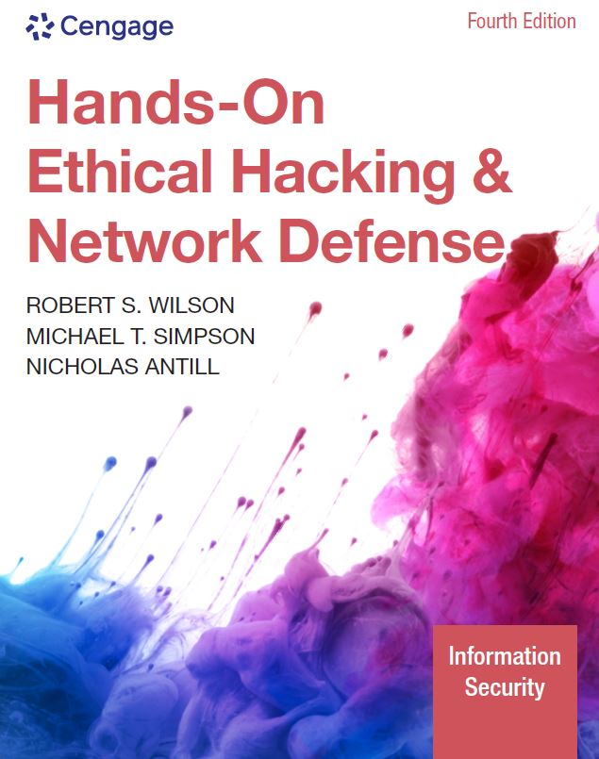
Hands-On Ethical Hacking and Network Defense, Edition 4
Module 11: Hacking Wireless Networks
Simpson, Antill, Wilson | Hands-On Ethical Hacking and Network Defense, 4th Edition. © 2023 Cengage. All Rights Reserved. May not be scanned, copied or duplicated, or posted to a publicly accessible website, in whole or in part.

Slide 2
Module Objectives
By the end of this module, you should be able to:
Explain wireless technology
Describe wireless networking standards
Describe the process of authentication
Describe wardriving
Describe wireless hacking and tools used by hackers and security professionals

Slide 3
Understanding Wireless Technology
For a wireless network to function, you must have:
The right hardware and software
Technology that sends and receives radio waves
Wireless technology is part of daily life
Baby monitors
Cell phones and smartphones
Global positioning system (GPS) devices
Keyless entry, remote controls, and garage door openers
Two-way radios
Bluetooth speakers

Slide 4
Components of a Wireless Network (1 of 3)
Only a few basic components:
Wireless network interface cards (WNICs)
Transmit and receive wireless signals
Access points (APs)
The bridges between wired and wireless networks
Wireless networking protocols
A portion of the RF spectrum

Slide 5
Components of a Wireless Network (2 of 3)
Access point (AP)
Radio transceiver that connects to a network via an Ethernet cable
Links a wireless LAN (WLAN) to a wired network
Not all connect to a wired network
Most companies use WLANs connected to the company’s wired network topology
Point where RF channels are configured
Enables users to connect to a LAN
Using wireless technology
Available only within a defined area

Slide 6
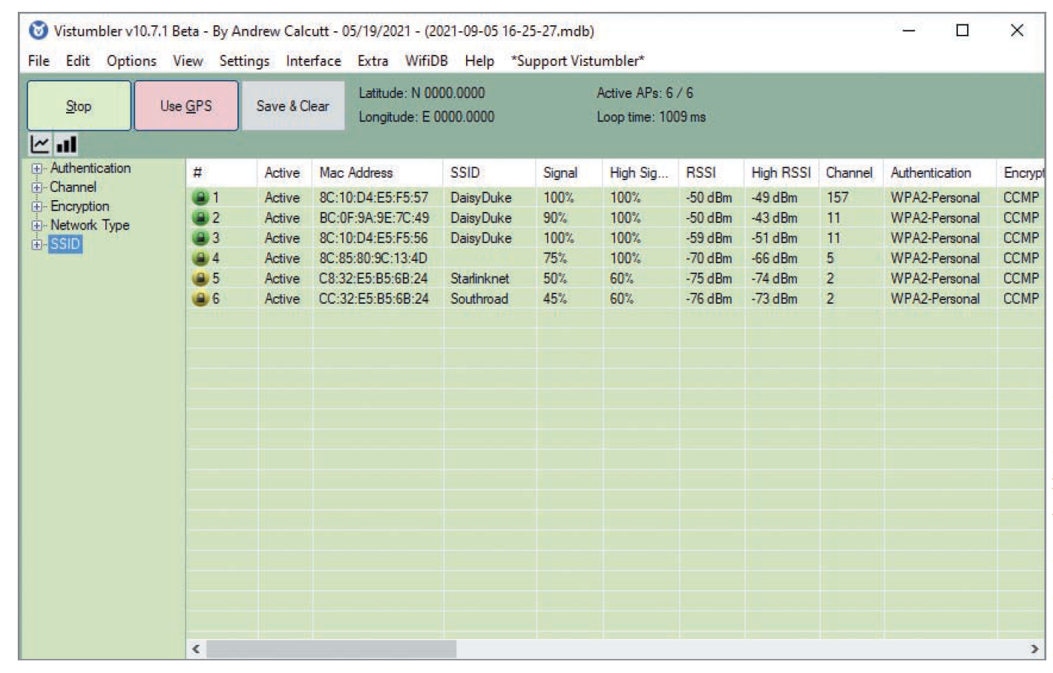
Components of a Wireless Network (3 of 3)
Source: GNU General Public License (GNU GPL)
Figure 11-1 AP channels detected

Slide 7
Service Set Identifiers (1 of 4)
SSID
Name used to identify a WLAN
Configured on the AP
Unique 1- to 32-character alphanumeric name
Case-sensitive

Slide 8
Service Set Identifiers (2 of 4)
To access the WLAN the AP connects to, wireless-enabled computers must configure with the same SSID as the AP
The SSID name is attached to each packet to identify it as belonging to that wireless network
AP usually broadcasts SSID several times a second
Users with WNICs can see a display of all WLANs within range of the AP’s signal

Slide 9
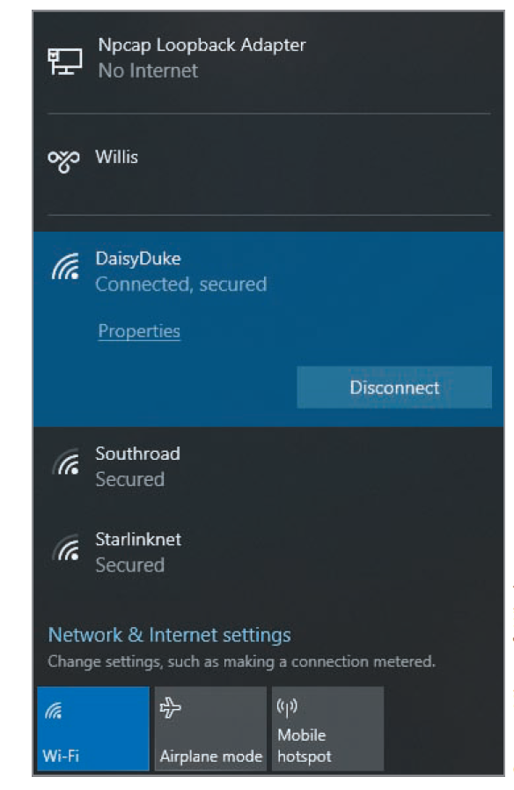
Service Set Identifiers (3 of 4)
Source: Microsoft Windows
Figure 11-2 SSIDs advertised to a Windows computer

Slide 10
Service Set Identifiers (4 of 4)
Vendors
Many have SSIDs set to a default value that companies never change
As a security professional, you must research constantly
Wireless hackers can attempt to guess SSID
Verify your clients are not using a default SSID
A default SSID
Tells an attacker that the target AP is out of date

Slide 11
Configuring an Access Point (1 of 4)
Configuring an AP varies
Depending on the embedded OS supplied by the manufacturer
Users can access the software through a web browser
Because the AP has an embedded OS supporting a web server
Accessing and reconfiguring a wireless router running dd-wrt:
Enter the IP address in a web browser
Provide the user logon name and password
After a successful logon, click the Status tab
Click the Wireless tab to display the Wireless Interface
Click the Wireless Security tab to configure security

Slide 12
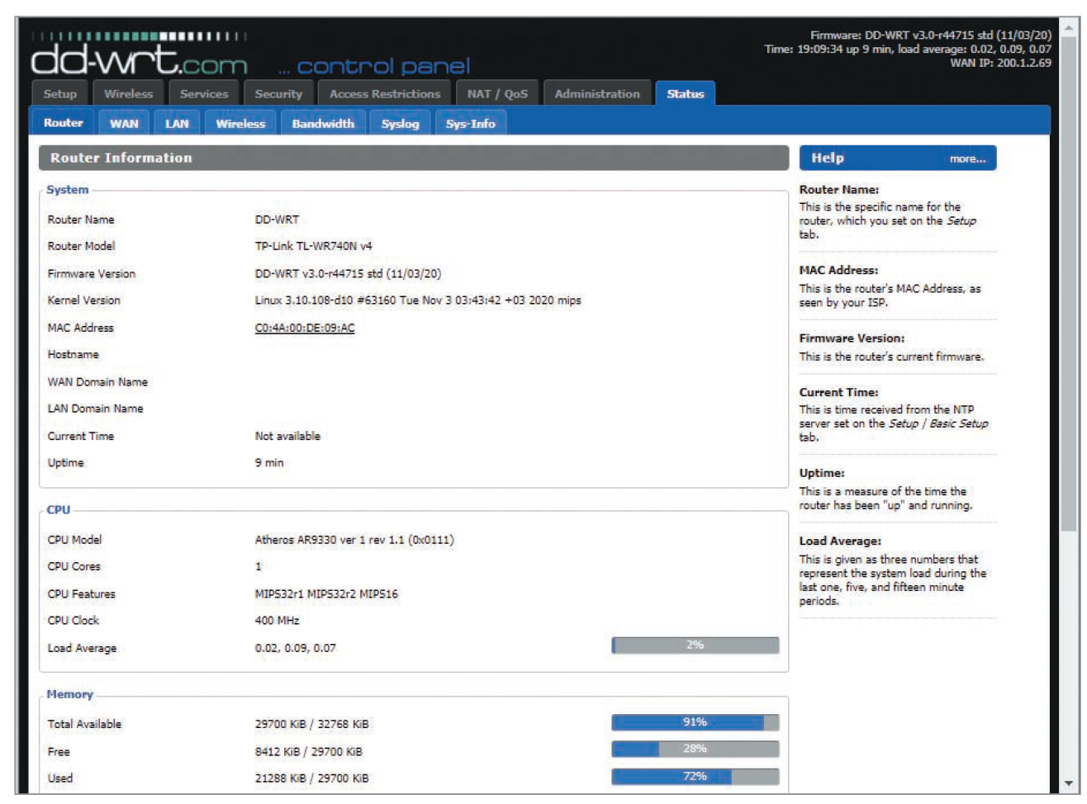
Configuring an Access Point (2 of 4)
Source: GNU General Public License (GNU GPL)
Figure 11-3 Viewing status information in dd-wrt

Slide 13
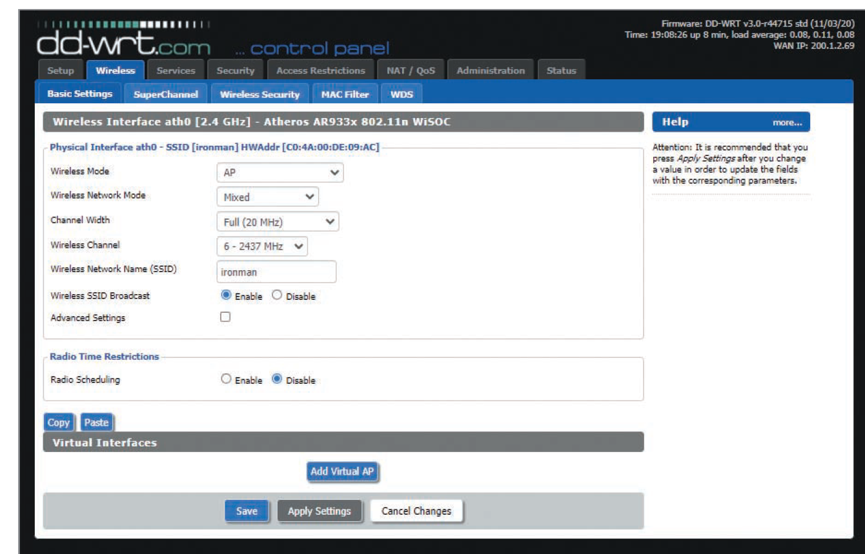
Configuring an Access Point (3 of 4)
Source: GNU General Public License (GNU GPL)
Figure 11-4 Basic wireless configuration in dd-wrt

Slide 14
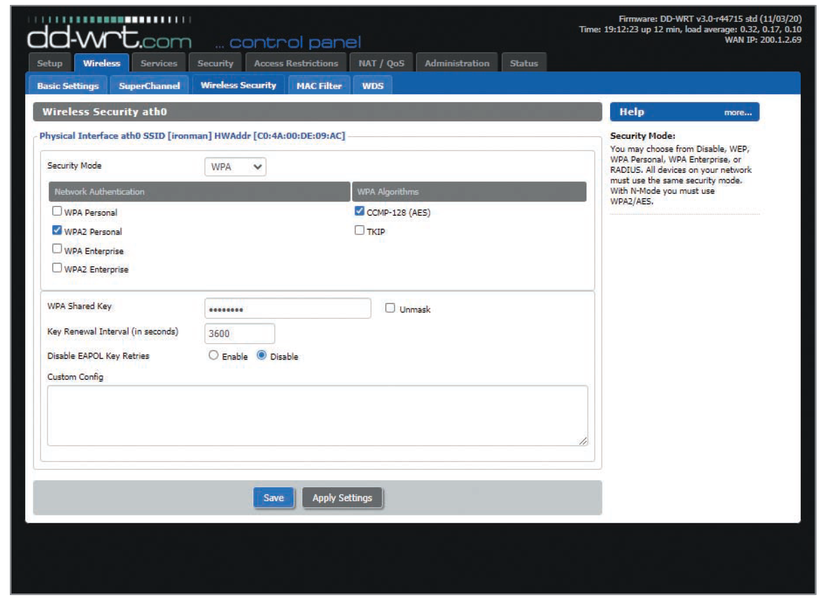
Configuring an Access Point (4 of 4)
Source: GNU General Public License (GNU GPL)
Figure 11-5 Configuring wireless security in dd-wrt

Slide 15
Wireless NICs
For wireless technology to work, each node or computer must have a WNIC
WNIC converts radio waves into digital signals the computer understands
There are many WNICs on the market
Be careful deciding which one to purchase
Some tools require certain specific brands

Slide 16
Understanding Wireless Network Standards
Standard
Set of rules formulated by an organization
Institute of Electrical and Electronics Engineers (IEEE)
Has standards specifying maximum cable length in an Ethernet network
Sets rules to follow for wireless networks
Working groups (WGs) of the IEEE are formed to develop new standards
IEEE Project 802: Developed to create LAN and WAN standards
WG names are assigned numbers
Example: 11 for the Wireless LAN group
Letters denote approved projects
Example: 802.11a or 802.11b

Slide 17
The 802.11 Standard
The first wireless technology standard
Defined specifications for wireless connectivity as 1Mbps and 2Mbps in a LAN
Applied to the Physical layer of the OSI model
Carrier sense multiple access/collision avoidance (CSMA/CA) is used instead of CSMA/CD (collision detection, used in Ethernet)
This is because radio signals can mix and cause a potential signal collision
Wireless LANs
Don’t have an address associated with a physical location
An addressable unit is called a station (STA)

Slide 18
The Basic Architecture of 802.11 (1 of 5)
802.11 uses a basic service set (BSS) as its building block
BSS
Collection of devices that make up a WLAN
Basic service area (BSA)
The coverage area an AP provides
A WLAN running in infrastructure mode
Always has one or more APs
Ad-hoc network
An independent WLAN without an AP

Slide 19
The Basic Architecture of 802.11 (2 of 5)
As long as a station is within its BSA, it can communicate with other stations in the BSS
To connect two BSSs:
802.11 requires a distribution system (DS) as an intermediate layer
BSS 1 connects to the DS, which in turn connects to BSS 2
Data moves between a BSS and the DS through the AP

Slide 20
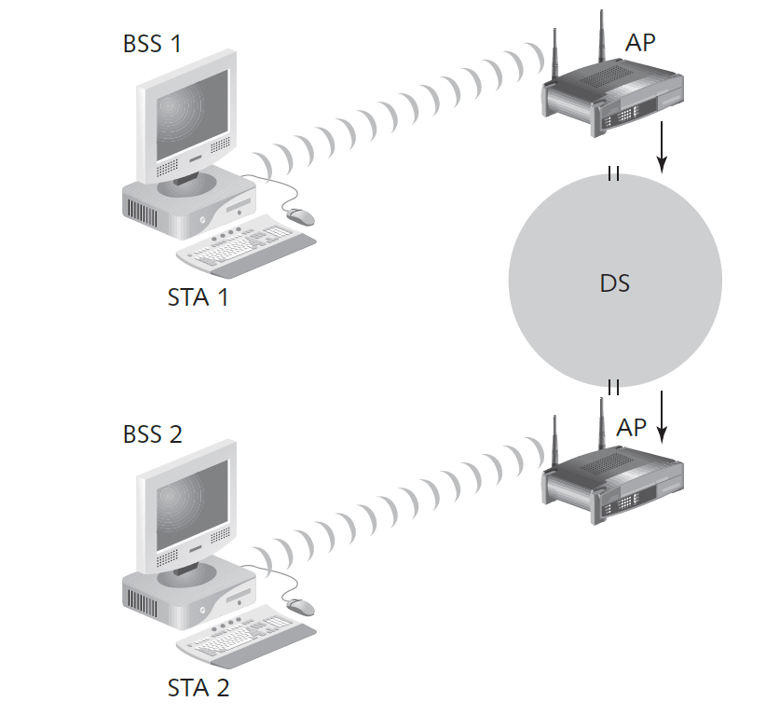
The Basic Architecture of 802.11 (3 of 5)
Source: Cengage
Figure 11-6 Connecting two wireless remote stations

Slide 21
The Basic Architecture of 802.11 (4 of 5)
IEEE specifications
Define the operating frequency range of 802.11
United States: The range is 2.4 to 2.4835 GHz
Each frequency band contains channels
A channel breaks up the band into smaller frequency ranges
The 802.11 standard defines 11 channels in the 2.4 to 2.462 GHz range
If channels overlap, interference could occur

Slide 22
The Basic Architecture of 802.11 (5 of 5)
The length of a sound wave is measured from the peak of one wave to the next
A sound wave’s amplitude (height) and frequency determine its volume and pitch
Frequency
Rate at which sound waves repeat
Cycle
Completion of a repeating pattern of sound waves
Bands
Different frequencies used by different technologies to transmit sound

Slide 23
Frequency Bands
Frequency | Range | Wavelength
Extremely low frequency (E L F) | 3 to 30 Hz | 100,000 km to 10,000 km
Super low frequency (SLF) | 30 to 300 Hz | 10,000 km to 1000 km
Voice frequency (VF) or ultra-low frequency (ULF) | 300 Hz to 3 KHz | 1000 km to 100 km
Very low frequency (VLF) | 3 to 30 KHz | 100 km to 10 km
Low frequency (LF) | 30 to 300 KHz | 10 km to 1 km
Medium frequency (MF) | 300 KHz to 3 MHz | 1 km to 100 m
High frequency (HF) | 3 to 30 MHz | 100 m to 10 m
Very high frequency (VHF) | 30 to 300 MHz | 10 m to 1 m
Ultra high frequency (UHF) | 300 MHz to 3 GHz | 1 m to 10 cm
Super high frequency (SHF) | 3 to 30 GHz | 10 cm to 1 cm
Extremely high frequency (EHF) | 30 to 300 GHz | 1 cm to 1 mm

Slide 24
An Overview of Wireless Technologies (1 of 2)
Infrared (IR) technology
Restricted to a single room or line of sight
Infrared light can’t be seen by the human eye
Cannot penetrate walls, ceilings, or floors
Narrowband
Uses microwave radio band frequencies to transmit data
Commonly used in:
Cordless phones
Garage door openers

Slide 25
An Overview of Wireless Technologies (2 of 2)
Spread spectrum
To move over radio waves, data must be modulated on the carrier signal or channel
Modulation
Defines how data is placed on carrier signal
Spread spectrum modulation
Data is spread across a large-frequency bandwidth instead of traveling across just one frequency band
Uses the following methods:
Frequency-hopping spread spectrum (FHSS)
Direct sequence spread spectrum (DSSS)
Orthogonal frequency division multiplexing (OFDM)
Orthogonal frequency division multiplexing Access (OFDMA)

Slide 26
Additional IEEE 802.11 Projects (1 of 5)
802.11b (referred to as Wi-Fi)
Operates in the 2.4 GHz band
Throughput increased to 11 Mbps from the 1 or 2 Mbps of the original 802.11
Allows for 11 separate channels to prevent overlapping signals
Only three channels (1, 6, and 11) can be combined without overlapping and creating interference
Introduced Wired Equivalent Privacy (WEP)

Slide 27
Additional IEEE 802.11 Projects (2 of 5)
802.11a standard
Has a different operating frequency range from 802.11 and 802.11b
Operates in three distinct bands in the 5 GHz range
Throughput increases to 54 Mbps
802.11g standard
Operates in the 2.4 GHz range
Because it uses a different modulation, it uses the OFDM method
Increases the throughput to 54 Mbps

Slide 28
Additional IEEE 802.11 Projects (3 of 5)
802.11i standard
Introduced Wi-Fi Protected Access (WPA)
Corrected many security vulnerabilities in 802.11b
Most important standard for security professionals
802.11e standard
Has improvements that address the problem of interference
When interference is detected, signals can jump to another frequency more quickly
802.11n standard
Operates in the same frequency and uses same encoding as 802.11g
Uses multiple antennas and wider channels
Increases the throughput to 600 Mbps

Slide 29
Additional IEEE 802.11 Projects (4 of 5)
802.11ac standard
Uses the 5 GHz band
Allows for higher throughput (up to 1 gigabit per second)
802.11ad standard
Dubbed “WiGig”
Allows for transfer rates up to 7 gigabits per second over the 2.4 GHz, 5 GHz, and 60 GHz bands

Slide 30
Additional IEEE 802.11 Projects (5 of 5)
802.11ah standard
Targets lower energy consumption
Creates extended-range Wi-Fi networks
802.11aj standard
Known as the China Millimeter Wave
Goal: Maintain backward compatibility with 802.11ad
Technology uses the 45 GHz and 60 GHz spectrums uniquely available in China
The 802.11x standard
Branded as Wi-Fi 6
Replaces 802.11ac as the de facto wireless standard
Wi-Fi 6 maxes out at 10 Gbps, uses less power, is more reliable in congested environments, and supports better security

Slide 31
Additional IEEE 802 Standards (1 of 2)
802.15 standard
Addresses networking devices in one person’s workspace
Wireless personal area network (WPAN)
Bluetooth is a common example
802.16 standard
Covers wireless metropolitan area networks (M A Ns)
Defines the Wireless M A N Air Interface for wireless M A Ns
Addresses the limited distance available for 802.11b WLANs
Worldwide Interoperability for Microwave Access (WiMAX)
Most widely used implementation of wireless M A N technology

Slide 32
Additional IEEE 802 Standards (2 of 2)
802.20 standard
Another M A N standard
Known as Mobile Broadband Wireless Access (MBWA)
Addresses wireless M A Ns for mobile users
Traveling in trains, subways, or cars at speeds up to 150 miles per hour
iBurst
Most common implementation of MBWA
Used widely in Africa and Asia

Slide 33
Summary of Approved Wireless Standards (1 of 2)
Standard | Frequency | Maximum rate | Modulation method
802.11 | 2.4 GHz | 1 or 2 Mbps | FHSS/DSSS
802.11a | 5 GHz | 54 Mbps | OFDM
802.11b | 2.4 GHz | 11 Mbps | DSSS
802.11g | 2.4 GHz | 54 Mbps | OFDM
802.11n | 2.4 GHz & 5 GHz | 600 Mbps | OFDM
802.11ac | 5 GHz | 1 Gbps | OFDM
802.11ad | 2.4 GHz, 5 GHz, & 60 GHz | 7 Gbps | OFDM
802.11ah | 900 MHz | 347 Mbps | OFDM
802.11aj | 45 GHz & 60 GHz | 15 Gbps | OFDM

Slide 34
Summary of Approved Wireless Standards (2 of 2)
Standard | Frequency | Maximum rate | Modulation method
802.11ax | 2.4 GHz & 5 GHz | 10 Gbps | OFDMA
802.15 | 2.4 GHz | 2 Mbps | FHSS
802.16 (WiMAX) | 10 to 66 GHz | 120 Mbps | OFDM
802.20 (Mobile Wireless Access Working Group) | Below 3.5 GHz | 1 Mbps | OFDM
Bluetooth | 2.4 GHz | 24 Mbps | Gaussian frequency shift keying (GFSK)
HiperLAN/2 | 5 GHz | 54 Mbps | OFDM

Slide 35
Understanding Authentication
Problem of unauthorized users accessing resources on a network
A major concern for security professionals
An organization that introduces wireless technology to the mix increases the potential for security problems

Slide 36
The 802.1X Standard
Defines the process of authenticating and authorizing users on a network
Basic concepts
Point-to-Point Protocol (PPP)
Extensible Authentication Protocol (EAP)
Wired Equivalent Privacy (WEP)
Wi-Fi Protected Access (WPA)
Wi-Fi Protected Setup (WPS)

Slide 37
Point-to-Point Protocol (PPP)
Many ISPs use PPP
To connect dial-up or DSL users
PPP handles authentication by requiring a user to enter a valid username and password
PPP verifies that users attempting to use the link are who they say they are

Slide 38
Extensible Authentication Protocol (EAP) (1 of 4)
EAP is an enhancement to PPP
Designed to allow a company to select its authentication method
Example:
A company can use certificates or Kerberos authentication to authenticate a user connecting to an AP
Certificate
Record that authenticates network entities, such as server or client
Contains X.509 information
Identifies the owner, the certificate authority (CA), and the owner’s public key

Slide 39
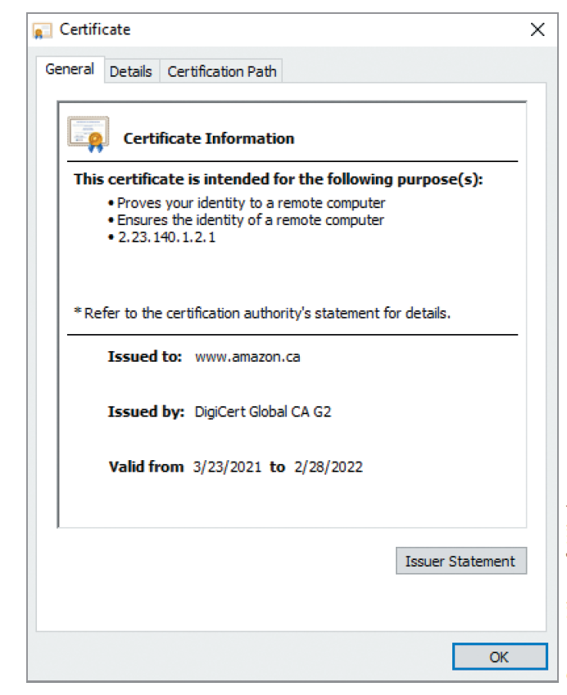
Extensible Authentication Protocol (EAP) (2 of 4)
Source: Microsoft Windows
Figure 11-7 Viewing information about an x.509 certificate

Slide 40
Extensible Authentication Protocol (EAP) (3 of 4)
EAP methods to improve security on wireless network:
Extensible Authentication Protocol-Transport Layer Security (EAP-TLS)
Protected EAP (P E A P)
Microsoft P E A P
802.1X uses the following components to function:
Supplicant
Authenticator
Authentication server

Slide 41
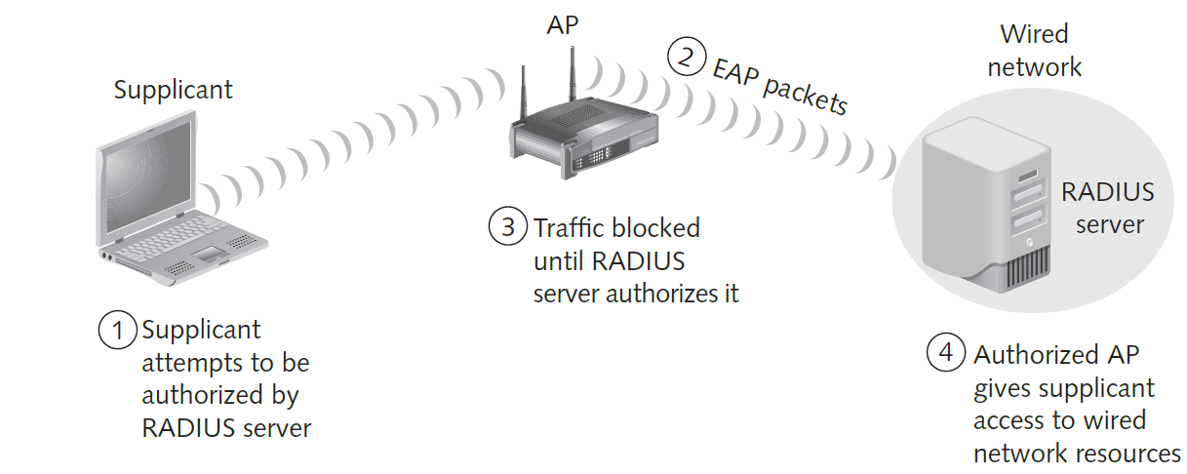
Extensible Authentication Protocol (EAP) (4 of 4)
Source: Cengage
Figure 11-8 A supplicant connecting to an AP and a RADIUS server

Slide 42
Wired Equivalent Privacy (WEP)
Part of the 802.11b standard
Developed to encrypt data traversing a wireless network
WEP encryption is easily cracked
Due to a flaw in its RC4 encryption algorithm
Works well for home users or small businesses when combined with the security of a Virtual Private Network (VPN)

Slide 43
Wi-Fi Protected Access (1 of 2)
WPA, WPA2, and WPA3
Specified in the 802.11i standard
Replacement for WEP
Improves encryption by using Temporal Key Integrity Protocol (TKIP) enhancements
TKIP’s four enhancements that address encryption vulnerabilities in WEP
Message Integrity Check (M I C)
Extended Initialization Vector (IV) with sequencing rules
Per-packet key mixing
Rekeying mechanism
Authentication mechanism using 802.1X and EAP

Slide 44
Wi-Fi Protected Access (2 of 2)
WPA3
Released in January 2018
Officially replaces WPA2 and provides improved security features
For encryption:
Uses AES-256 and SHA-384 in WPA3-Enterprise mode
Mandates the use of CCMP-128 (AES-128 in CCM Mode) as the minimum encryption algorithm in WPA3-Personal mode
Uses Simultaneous Authentication of Equals (SAE) exchange
Results in a more secure initial key exchange
Difficult for hackers to tap into a network using offline password-guessing attacks
Susceptible to timing attacks during the handshake process
Information gathered can be used for a password partitioning attack

Slide 45
Wi-Fi Protected Setup (WPS)
WPS
A wireless authentication standard created to allow users to add devices easily and securely to a wireless network
Eliminates the need for a user to enter a passphrase
User simply presses a button on the router
The WPS-able device pairs with the router
Flaw discovered in 2011
Allows an attacker to gain access to a network remotely without knowing the WPA2 password

Slide 46
Knowledge Check Activity 11-1
Which IEEE standard defines authentication and authorization in wireless networks?
802.11
802.11a
802.11b
802.1X
Notes:
Instructions:
Use the Knowledge Check questions to periodically pose a question to students during class to gauge how well they can recall the material that was presented.

Slide 47
Knowledge Check Activity 11-1: Answer
Which IEEE standard defines authentication and authorization in wireless networks?
Answer: d. 802.1X
The 802.1X standard defines the process of authenticating and authorizing users on a network. This standard is especially useful for WLAN security when physical access control is more difficult to enforce than on wired LANs.

Slide 48
Polling Activity 11-1
Which wireless encryption standard offers the best security?
WPA3
WEP
WPS
WPA
Notes:
Instructions:
1. Use this activity to solicit student opinions about concepts in the module or to play a game.
2. Go to kahoot.com, or the platform of your preference, and log in or sign up.
3. Create the challenge.
4. Teacher Tip: Turn off the timer to prioritize accuracy or turn on the nickname generator to avoid inappropriate nicknames.
5. Invite players by sharing the link or PIN.
6. This can be done synchronously during class or asynchronously for review or homework.

Slide 49
Polling Activity 11-1: Answer
Which wireless encryption standard offers the best security?
Answer: a. WPA3
WPA3 makes it more difficult for hackers to tap into a network using offline password-guessing attacks. WPA2 would allow hackers to capture data from your router and use this data to repeatedly attempt to guess your password, but with WPA3, one incorrect hacking attempt renders this data useless. WPA3 also improves security over public Wi-Fi networks.

Slide 50
Knowledge Check Activity 11-2
What protocol was added to 802.11i to address WEP’s encryption vulnerability?
MIC
TKIP
TTL
EAP-TLS
Notes:
Instructions:
Use the Knowledge Check questions to periodically pose a question to students during class to gauge how well they can recall the material that was presented.

Slide 51
Knowledge Check Activity 11-2: Answer
What protocol was added to 802.11i to address WEP’s encryption vulnerability?
Answer: b. TKIP
Temporal Key Integrity Protocol (TKIP) was added to the 802.11i standard as WEP was known to have cryptographic weaknesses. WEP was replaced by Wi-Fi Protected Access (WPA).

Slide 52
Understanding Wardriving
Hackers use wardriving
Driving around with inexpensive hardware and software that enables them to detect unsecured APs
Wardriving is not illegal
But using the network resources discovered with wardriving is illegal

Slide 53
How It Works
An attacker or security tester drives around with the following equipment:
A Wi-Fi capable smartphone or laptop and software that scans the areas for SSIDs
WNIC
Not all are compatible with scanning software
Review the software requirements before purchasing the hardware
Antenna prices vary depending on the quality and the range that they can cover
Most scanning software identifies:
The company’s SSID
The security type enabled
The signal strength

Slide 54
Vistumbler (1 of 3)
Freeware tool written for Windows that enables WLAN detection using certain access points
802.11a, 802.11b, 802.11g, 802.11n, and 802.11ac
Easy to install
Primarily designed to assist security testers in the following:
Verify WLAN configuration
Detect other wireless networks that might be interfering with a WLAN
Detect unauthorized APs that might have been placed on a WLAN
Capable of connecting to a GPS
Enables a security tester or hacker to map locations of all WLANs the software detects

Slide 55
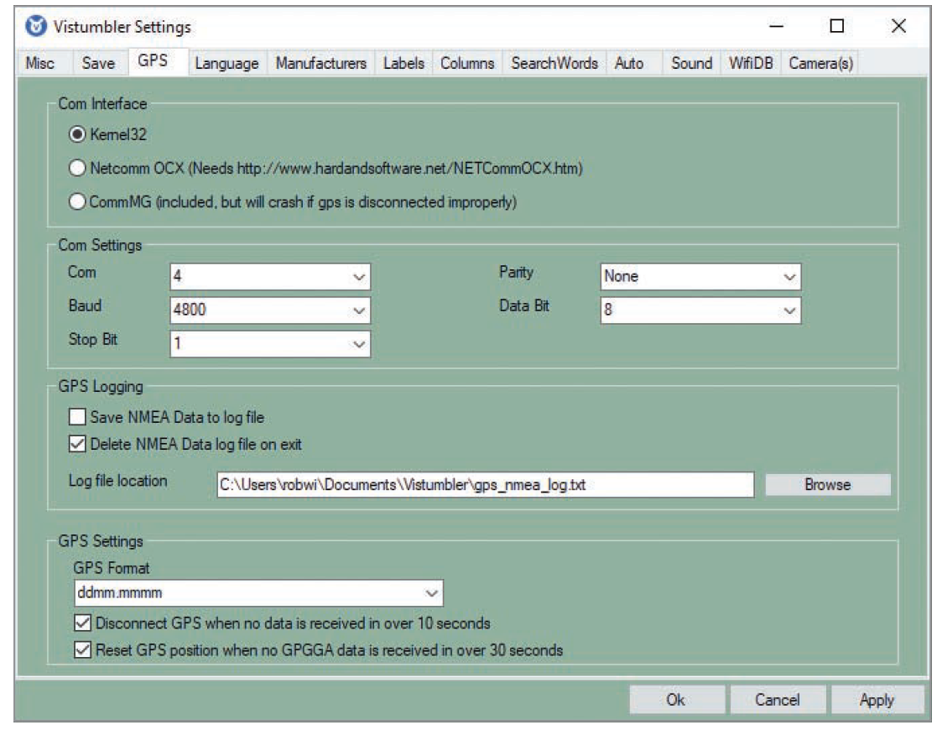
Vistumbler (2 of 3)
Source: GNU General Public License (GNU GPL)
Figure 11-9 Configuring GPS settings in the Vistumbler Settings dialog box

Slide 56
Vistumbler (3 of 3)
When Vistumbler identifies an AP signal, it logs the following:
The SSID
The MAC address
The manufacturer of the AP
The channel on which the signal was heard
The signal strength
Whether encryption is enabled
Attackers can detect APs within a 350-foot radius
With better antennas, they can locate APs a couple of miles away

Slide 57
Kismet (1 of 2)
Product for conducting wardriving attacks
Written by Mike Kershaw
Runs on Linux, BSD UNIX, macOS, and Linux PDAs
A sniffer and an intrusion detection system (IDS)
Can sniff 802.11b, 802.11a, 802.11g, 802.11n, 802.11ac, and 802.11ax traffic
Features:
Wireshark- and Tcpdump-compatible data logging
Compatible with AirSnort and AirCrack
Network IP range detection
Detection of hidden network SSIDs

Slide 58
Kismet (2 of 2)
Features (continued):
Graphical mapping of networks
Client or server architecture that allows multiple clients to view a single Kismet server at the same time
Manufacturer and model identification of APs and clients
Detection of known default AP configurations
XML output
Supports for dozens of card types

Slide 59
Polling Activity 11-2
What information can be gathered by wardriving? (Choose all that apply.)
SSIDs of wireless networks
Whether encryption is enabled
Whether SSL is enabled
Signal strength
Notes:
Instructions:
1. Use this activity to solicit student opinions about concepts in the module or to play a game.
2. Go to kahoot.com, or the platform of your preference, and log in or sign up.
3. Create the challenge.
4. Teacher Tip: Turn off the timer to prioritize accuracy or turn on the nickname generator to avoid inappropriate nicknames.
5. Invite players by sharing the link or PIN.
6. This can be done synchronously during class or asynchronously for review or homework.

Slide 60
Polling Activity 11-2: Answer
What information can be gathered by wardriving?
Answer: a., b., and d. SSIDs of wireless networks, whether encryption is enabled, and signal strength
In wardriving, most scanning software detects the company’s SSID, the type of security enabled, and the signal strength, indicating how close the access point (AP) is to the attacker.

Slide 61
Discussion Activity 11-1
Discuss Temporal Key Integrity Protocol and identify which TKIP enhancement addresses the WEP vulnerability of forging packets.
Notes:
Instructions:
Use the Discussion activity to encourage group conversation about a related topic of interest.

Slide 62
Discussion Activity 11-1: Answer
Discuss Temporal Key Integrity Protocol and identify which TKIP enhancement addresses the WEP vulnerability of forging packets.
Answer: Message Integrity Check (MIC)
Explanation: Temporal Key Integrity Protocol (TKIP) is used by Wi-Fi Protected Access (WPA) to improve encryption. TKIP has four enhancements that address vulnerabilities in WEP. The vulnerability of forging packets is addressed by the Message Integrity Check (MIC) enhancement. MIC, pronounced M-I-C and also called Michael, is a cryptographic message integrity code. Its main purpose is to prevent forgeries, which are packets that attackers create to look like legitimate packets.

Slide 63
Understanding Wireless Hacking
Hacking a wireless network
Not much different from hacking a wired LAN
Techniques
Port scanning
Enumeration tools

Slide 64
Tools of the Trade (1 of 4)
Equipment:
Laptop computer
WNIC
Antenna
Sniffers
Tools for cracking WEP or WPA keys:
Aircrack-ng

Slide 65
Tools of the Trade (2 of 4)
Aircrack-ng
The tool most hackers use to access WEP-enabled WLANs
Replaced AirSnort
Has some useful add-ons
GUI front-end called Fern WIFI Cracker

Slide 66
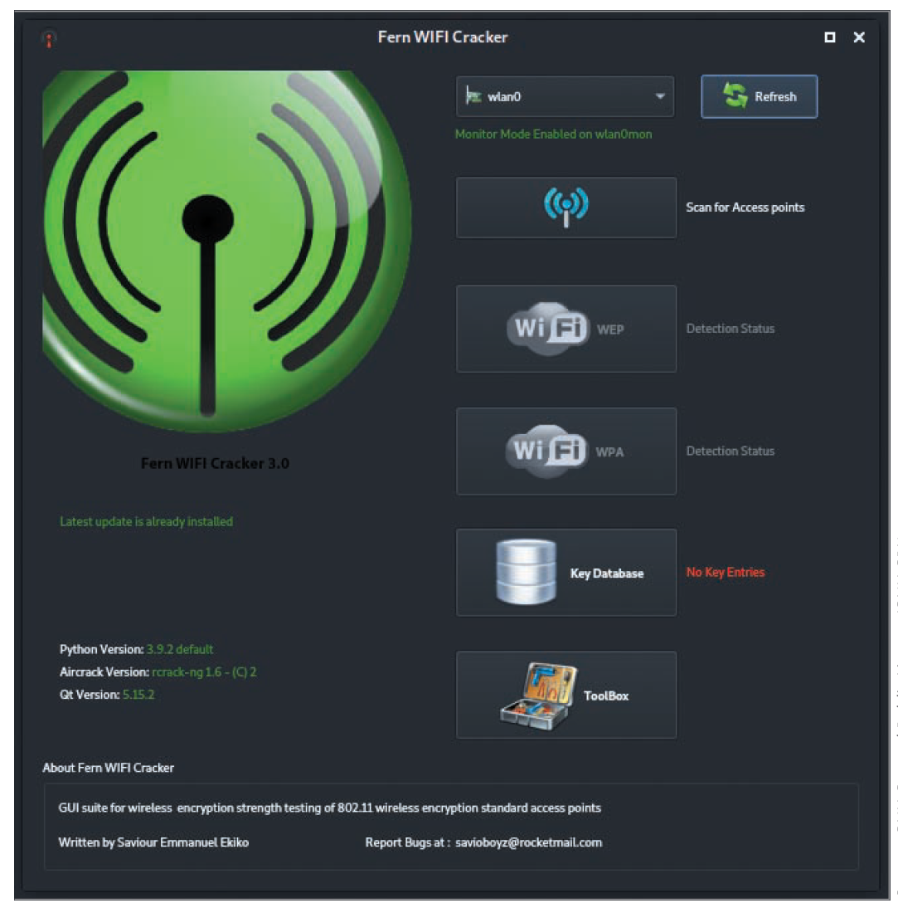
Tools of the Trade (3 of 4)
Source: GNU General Public License (GNU GPL)
Figure 11-11 Fern WIFI Cracker interface

Slide 67
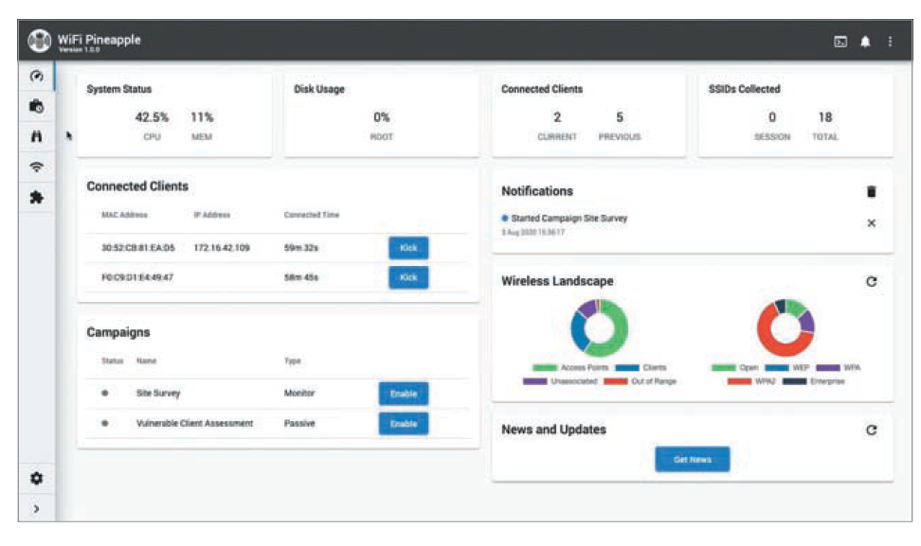
Tools of the Trade (4 of 4)
Source: Hak5 LLC
Figure 11-12 WiFi Pineapple interface

Slide 68
Countermeasures for Wireless Attacks (1 of 3)
Consider using anti-wardriving software
Makes it more difficult for attackers to discover your WLAN
Honeypots
Use measures for preventing radio waves from leaving or entering the building
Use a certain type of paint on the walls
Use a router to only allow approved MAC addresses to access your network

Slide 69
Countermeasures for Wireless Attacks (2 of 3)
Consider using an authentication server to authenticate users
Instead of relying on a wireless device
Consider using EAP
Allows using different protocols that enhance security
Consider placing the AP in the demilitarized zone (DMZ)
Use a firewall in front of the company’s internal network that filters out traffic from unauthorized IP addresses
If possible, upgrade to WPA2 or WPA3, and replace hardware that can’t be upgraded

Slide 70
Countermeasures for Wireless Attacks (3 of 3)
Assign static IP addresses to wireless clients
Instead of using DHCP
Disable WPS
Removes the known WPS attack vectors
Change the default SSID and disable SSID broadcasts
If you can’t disable SSID broadcasts, rename default SSID

Slide 71
Self-Assessment
What are the different types of attacks that an enterprise faces today?
What are the threats and vulnerabilities associated with embedded and specialized devices and mobile devices?
Notes:
Instructions:
Use the Self-Assessment question to encourage students to evaluate their progress or goals in the course, as well as determine how they might apply their learning or grow as an individual.

Slide 72
Summary
Now that the lesson has ended, you should be able to:
Explain wireless technology
Describe wireless networking standards
Describe the process of authentication
Describe wardriving
Describe wireless hacking and tools used by hackers and security professionals

